Slide 1
“No Butts About It,
Let’s Wipe It Away…..”
Debra Berube MS RNC CIC
Director of Infection Control & Prevention
St Vincent Hospital
Worcester MA
APIC NE
October 13, 2011

Slide 2

Brief Outline
C.Diff rates, historical, current, and goals
Contact Plus precautions and its implementation
Hand Hygiene program
  rates
  compliance observations
  non-compliance
Team effort
What’s next

Slide 3
2008-2010
SVH: C.Diff rates
Per 10,000 patient days
2011

Slide 4
2008-2009 9.55 to 6.15 | 35%
2009-2010 6.15 to 6.54 | 1%
2010-2011 6.54 to 4.12 | 37%
2008-2011 9.55 to 4.12 | 57%
SVH: C. Diff: Rate per 10,000 pt days
2008-2011 (through September)

Slide 5

This NO FOAM sign is posted in addition to Contact Precautions sign
Alcohol foam is removed from inside of the patient room
Patient and family education
Terminal clean upon transfer or discharge
NO FOAM ROOM
PLEASE WASH HANDS
WITH SOAP AND WATER
PRIOR TO LEAVING

Slide 6
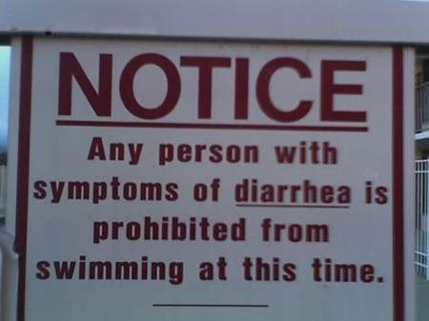
Infection Preventionists:
Maintain daily list of all patients
admitted that have MDRO, C.Diff.
This list includes all other types
of isolation as well.
Along with staff, maintain
appropriate environmental controls
Daily rounding on all patients in isolation
Patient education oversight of all patients with MDRO including
C.Diff. Daily reminder to nursing staff of patient education needs.
Patient education brochures: MA DPH, CDC, Krames On-Demand
Dissemination of monthly data to all nursing areas
Environmental controls

Slide 7
Amount of emphasis on hand hygiene and rates of HAI C. Diff seem to go hand in hand at our facility.
Hmmm.....
That would mean: if hand hygiene rates increase then HAI C. Diff would decrease.
All other HAI’s will follow....

Slide 8

Hand Hygiene Program
Education upon orientation, annual competencies, as needed
Patients, visitors encouraged to wash hands
Daily update at morning huddle:
    current rate, # observations done, days left in the month
Movie themed posters:
  Field of Germs
  Staph Wars
  E.G. the Extra-Germestrial
  etc.
Other posters rotated to prevent sign fatigue

Slide 9
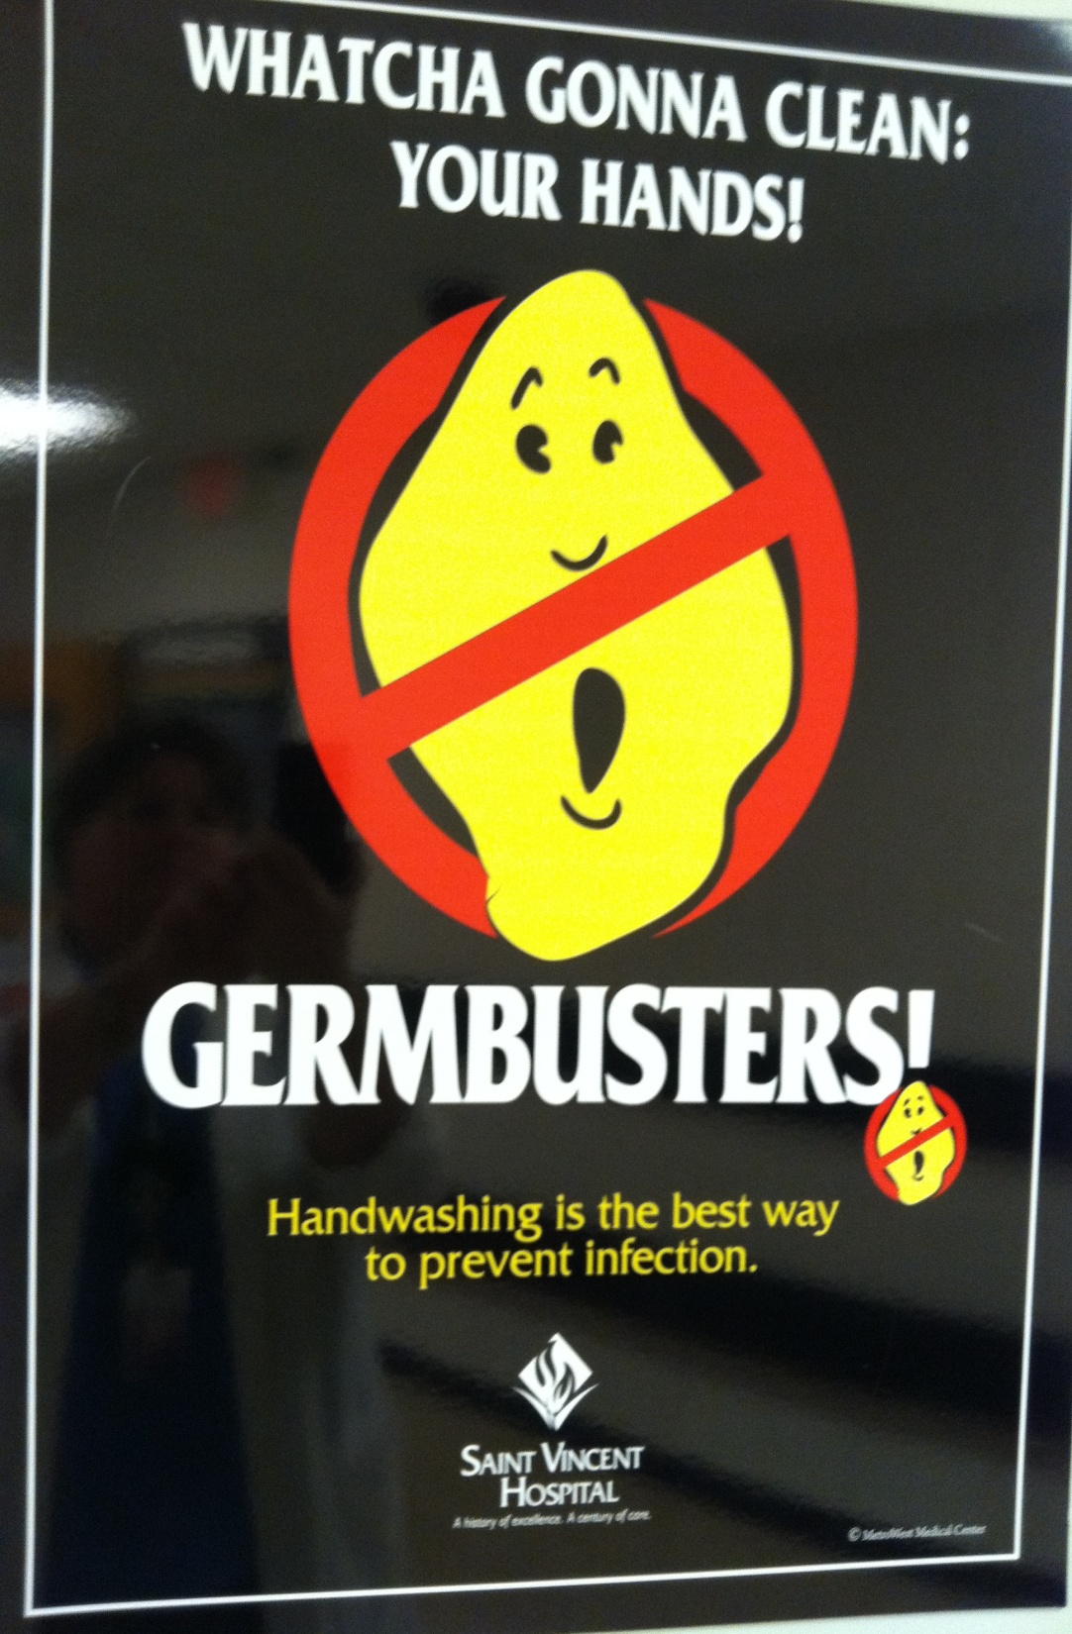
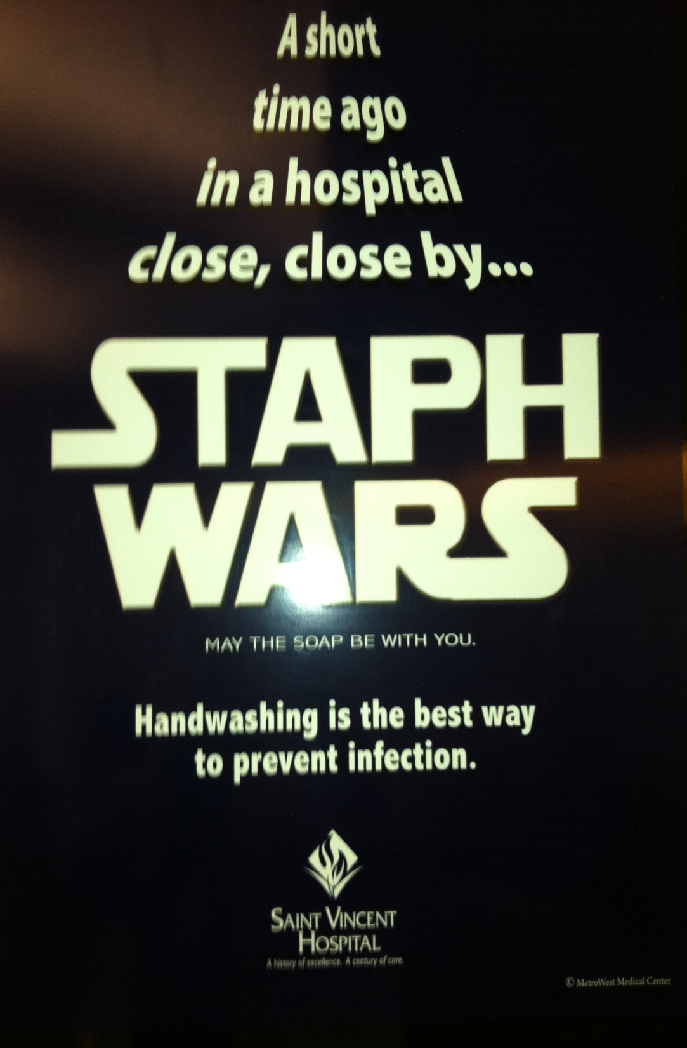

Slide 10

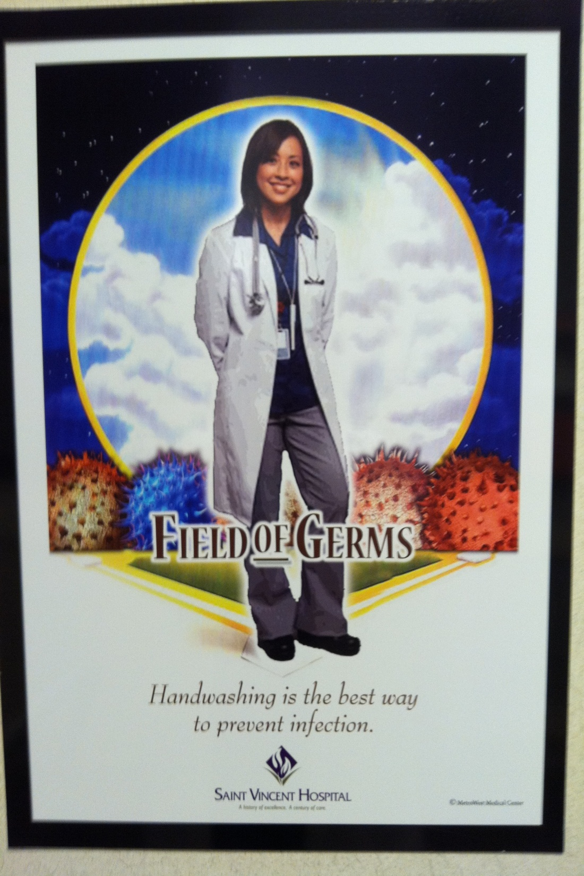

Slide 11

The posters :
  20 x 26 inches
  professionally printed
  for staff and visitors..... patient empowerment!
  washable
  eye-catching!!
  fun
Problems:
  poster / sign fatigue
    rotate them unit unit
    create new ones
    move locations

Slide 12
12 different posters of children and animals, 8 ½ x 11 inches, laminated, washable.

Slide 14

Small 4 x 3 ½ inch magnetized signs that are attached to every patient doorway
Problem:
  They tend to “disappear” and must be replaced frequently.
  IC practitioner carries them during daily rounds for replacing.
Always Foam OUT
Always Foam IN
Clean Hands
Save Lives

Slide 15

Hand Hygiene Program
(continued)
Hand hygiene monitoring
  46 hand hygiene observers
  each observer has monthly assignment to specific units
  minimum of 500 observations per month (more is always OK!!!)
  real-time feedback
  NO person is exempt from being observed
  IP cannot observe for statistics.......are considered “biased”
  IP’s can issue “tickets” if violations are observed by IP’s
  “Ticket” for attending physicians results in $100 fine per violation, must be paid before allowed to recredential
  Weekly update sent via email to all observers and leadership team

Slide 16





Thanks for being a STAR and
keeping our patients safe!
♪ You were observed performing Hand Hygiene ♪
Name: _______________________________________
Date: _______________________________________
Observer:_______________________________________
Infection Control Committee: Violation Documentation Form
Date of Event: ________________ Location: _______________
Name of Person Observed ___________________________________
Deviation (check all that apply):
Was observed not disinfecting hands before / after direct patient contact ______
Was observed not adhering to posted precautions ______
3. Was observed eating or drinking in patient care area. ______
Was seen inappropriately discarding infectious waste ______
Action:
Deviation brought to person’s attention Yes No
Comment:
________________________________________________________
_________________________________________________________
Name of person completing form:_________________________
Approved by SVH Infection Control Committee July 2008

Slide 17
Hand Hygiene Compliance
Rate per 100 Observations
2011
2010

Slide 18

Goals:
Decrease hospital acquired C.Diff by 25%
by the end of 2011. Will set new goals for 2012.
Decrease overall hospital acquired infections
Increase hand hygiene rates to ??? 100%
  Continue to engage front line staff regularly
Increase patient education regarding:
    transmission, prevention, empowerment, etc.
Maintain and increase effective environmental cleaning
  Bleach wipes in ICU and other areas when appropriate
  Cleaning is everyone's responsibility, not just “housekeeping”
Maintain IP visibility on patient care units (this is NEVER ending!!)
GO Patriots!

Slide 19


Team Effort
All staff are responsible for patient safety
Infection prevention is patient safety
Safety trumps all!!!
Take away messages:
Wash, Wash, Wash (both hands and surfaces)
Include all clinical disciplines in the prevention of infection
Cleaning is everyone's responsibility, not just “housekeeping”
If something isn’t working, then step back and look at the big
and little picture again. Use rapid cycle PDSA (plan, do, study, act)
Reach out for help!! Either on a unit, supervisor, another discipline,
another facility.............include all appropriate disciplines

Slide 20
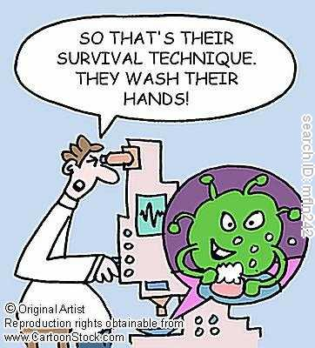
Questions???

Slide 21


Debra Berube MS RNC CIC
Director of Infection Prevention
St. Vincent Hospital
123 Summer St, Worcester MA 01608
Office: 508-363-6240
debra.berube@stvincenthospital.com

